Slide 1
Dark Silicon and Conservation Cores
CS 252A Paper Reviews
Presented by: Jack Toubes & Tofic Esses

Slide 2
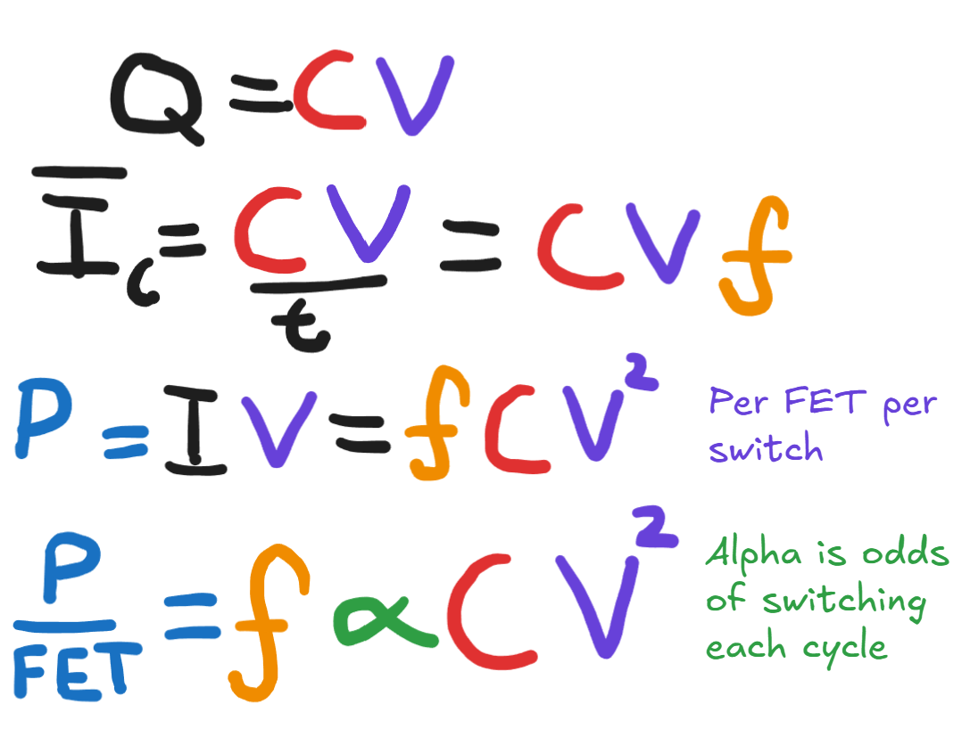
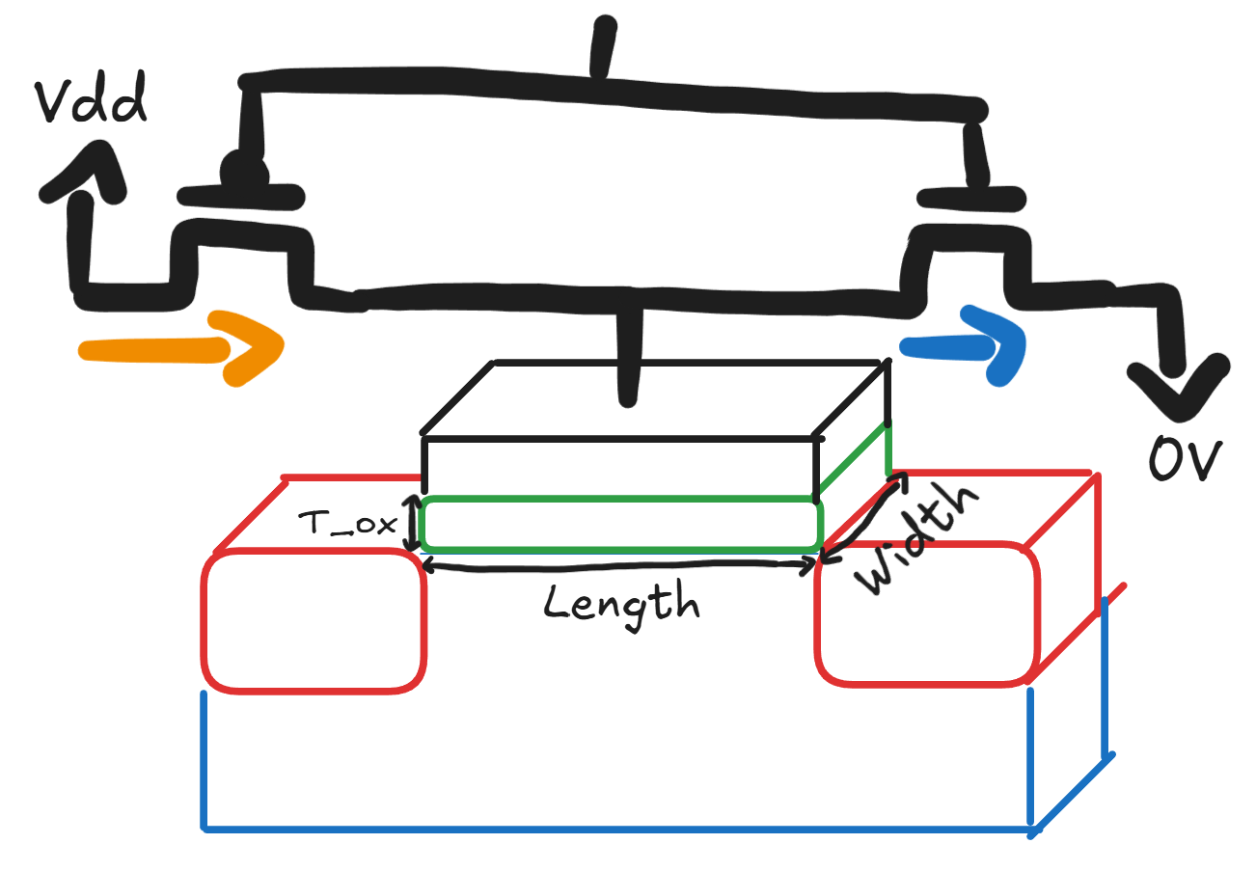
Background: MOSFET Switching Power
Notes:
If people need
Capacitor is C = Q/V; Q = CV
Charging capacitor requires CV charge to be drawn from supply. Discharging requires CV to be discharged to ground.
Average current over full charge discharge cycle is CV/t where t is the length of the cycle. If we use the clock frequency to define the length of the cycle, we get average current is CVf.
P = IV = CV^2f each time a transistor switches.
Let’s say it switches with probability a each cycle
P/fet = aCV^2f
C is proportional to LW / t_ox

Slide 3
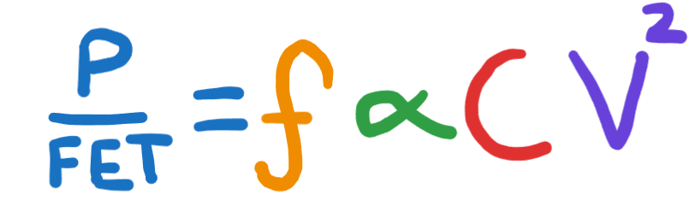
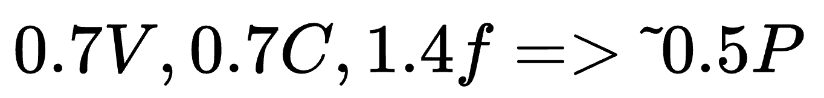
Background: Dennard Scaling
Dennard scaling relies on reducing the driving voltage (V) and capacitance (C) to enable increases in frequency (f) and # of transistors (N_fet).
Each generation, increase frequency AND halve the power per transistor.
Notes:
In practice, because we had room in the power budget, power rose over generations. But it didn’t need to necessarily.

Slide 4
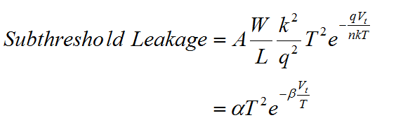
Breakdown of Dennard Scaling
Dennard scaling relies on reducing the driving voltage (V) and capacitance (C) to enable increases in frequency (f) and # of transistors (N_fet).
Each generation, increase frequency AND halve the power per transistor.
BUT, as transistors get smaller, reducing their threshold voltage (necessary to enable reducing driving voltage) exponentially increases leakage power.

Slide 5
Power Wall & Dark Silicon
Our cooling technologies can only (economically) cool a certain amount of power dissipated (hence why power-consumption is often listed as Thermal Design power).
Power Wall: Chips must only consume power which can be dissipated by economical cooling technologies.
Dark silicon: with the failure of Dennard scaling, not all of the transistors which can fit on a chip can be switching at their maximum speed at the same time, without slamming into the power wall.

Slide 6
It’s 2004 and we’re running into a problem
2004: Choose between increasing frequency and increasing # of transistors
  We chose increasing # of transistors -> Multicore processors

Slide 7
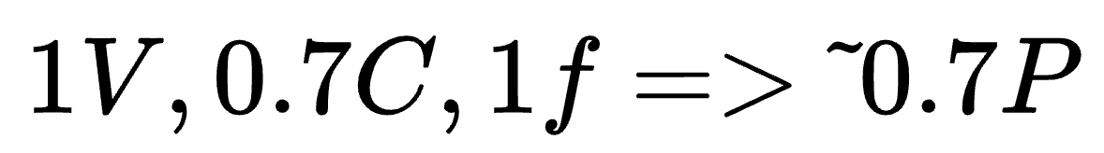
Another Breakdown of Dennard Scaling
We’ve stopped increasing frequency, but we’re still doubling the number of transistors on the chip every generation.
0.7 * 2 = 1.4! We’re now increasing total power with number of transistors :(

Slide 8
It’s 2011 and we’re running into a problem
2004: Choose between increasing frequency and increasing # of transistors
  We chose increasing # of transistors -> Multicore processors
2011: Can fit more transistors on a processor but can’t fully power all of them at the same time.
  What do we do???

Slide 9
Dark Silicon and the End of the world Multicore Scaling
A CS 252a Presentation
Jack Toubes
2026-2-4

Slide 10
The Question
It’s 2011: we’ve had to start giving transistors less power.
What do we expect to get from multicore scaling in the next 15 years?

Slide 11
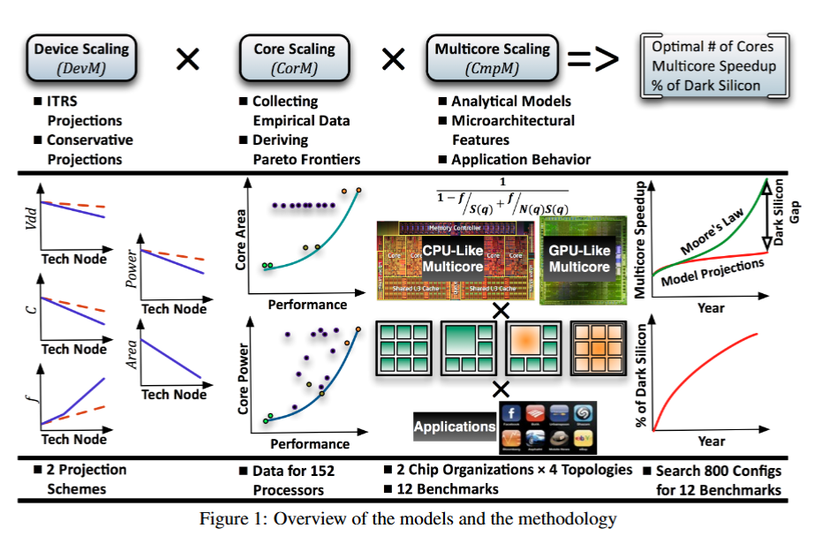
Methodology
Bottom up multicore PPA model
  Device model for capturing effects of transistor scaling
  Core model for capturing a pareto frontier of architectures
  Multicore model for capturing different topologies & microarchitectures and considering different workloads

Slide 12
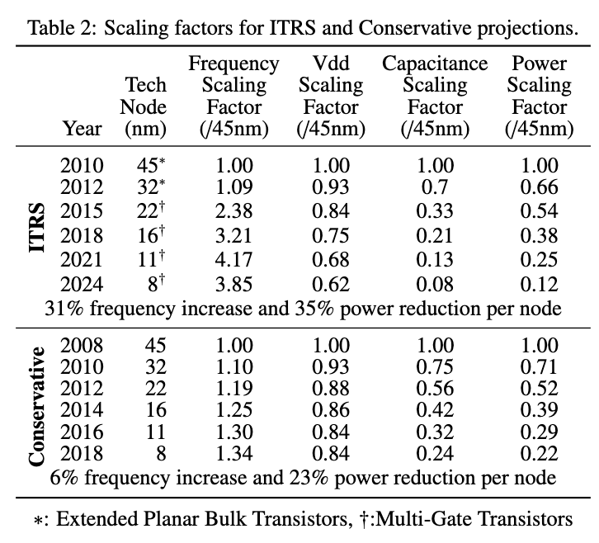
Device Scaling Model (DevM)
Predict transistor frequency, voltage, capacitance, and power scaling for future technology nodes.
Large capacitance & frequency jumps from 32 to 22 because of “multi-gate” (FinFet) transistors.
  FinFet significantly reduces leakage.

Slide 13
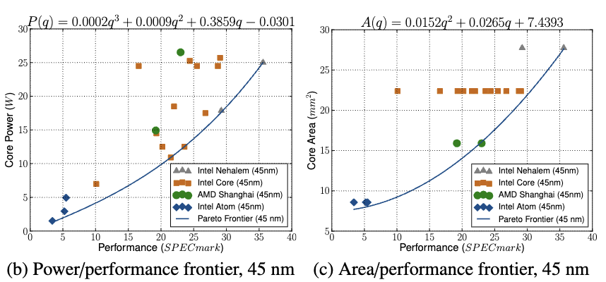
Core Scaling Model (CoreM)
Notes:
Shows best core configuration for a given power and area.

Slide 14
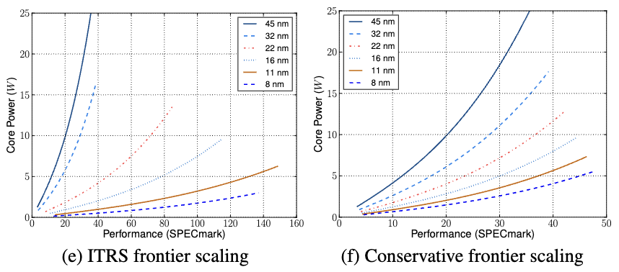
DevM X CoreM
Notes:
Perf assumed to scale linearly with frequency (may not be accurate)

Slide 15
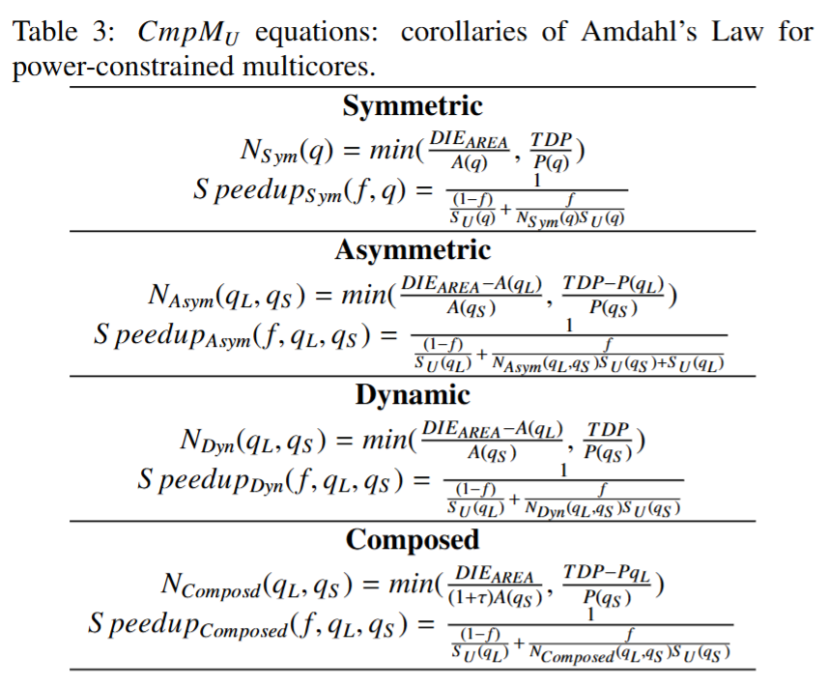
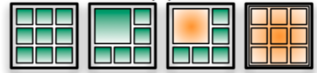
Theoretical Multi-core Performance (CmpMu)
Theoretical limits on the performance improvements of multi-core with different system topologies
Notes:
Dynamic is asymmetric but turn off the big core for parallel portions (to give more power to the smaller cores).
Composed is small cores can fuse into big core for sequential portions.

Slide 16
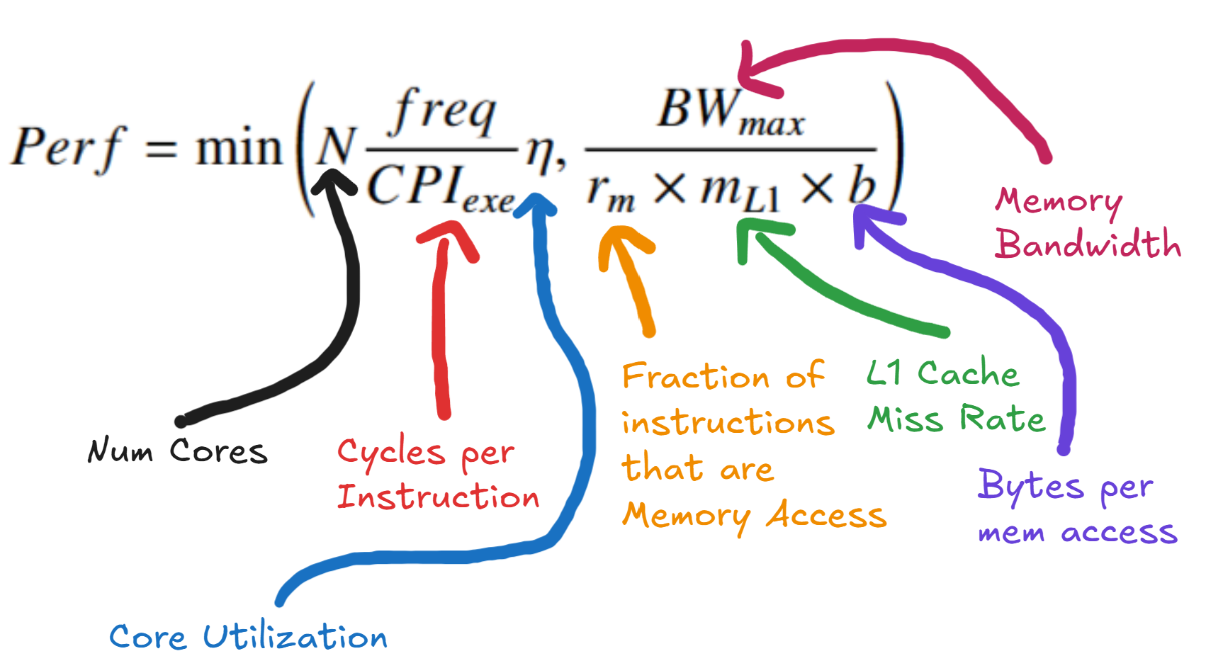
Realistic Multi-core Performance (CmpMr)
Notes:
CPI is acquired synthetically based on the SPEC benchmark performance to equalize the CmpMr ratio to the ratio in SPEC performance.

Slide 17


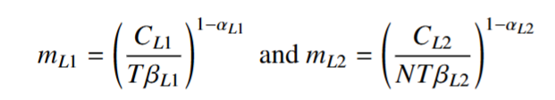
Realistic Multi-core Performance (CmpMr)

Slide 18
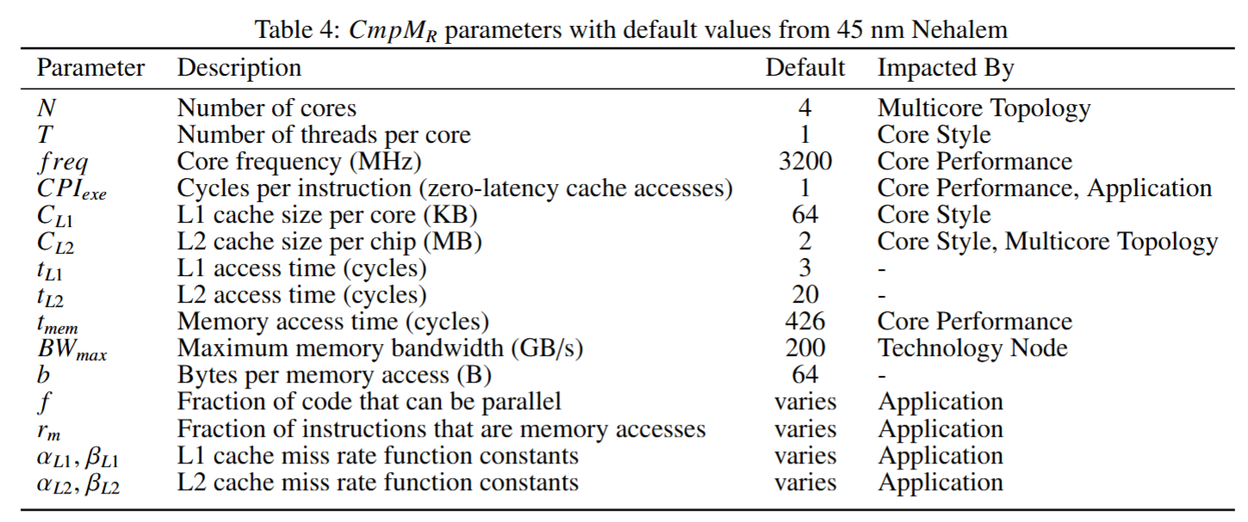
Realistic Multi-core Performance (CmpMr)

Slide 19
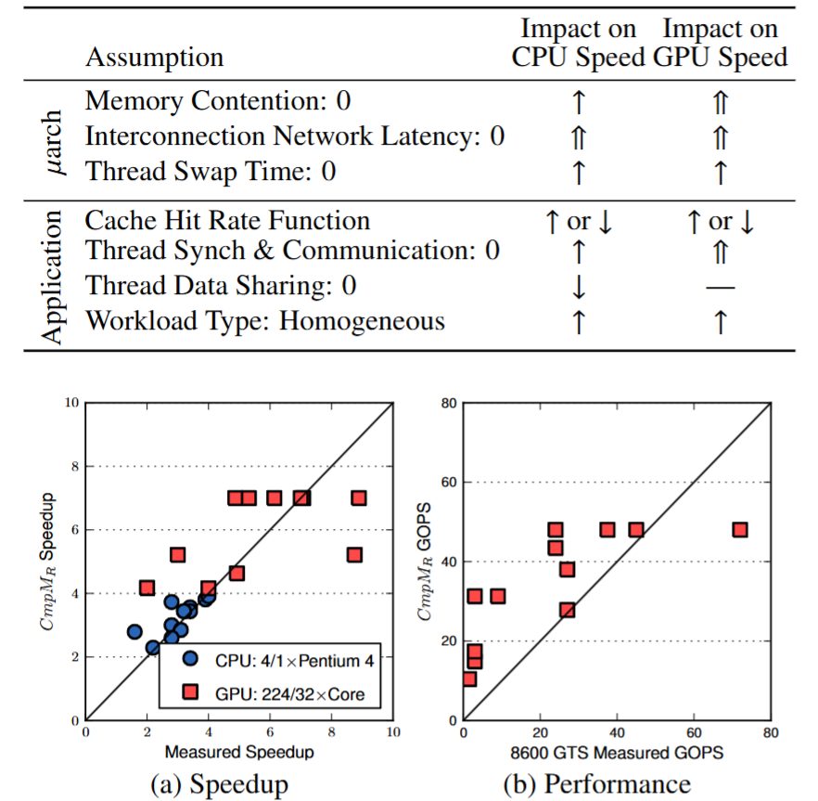
Realistic Multi-core Performance (CmpMr)
Model designed to over-estimate performance with first-order models
Model is validated by comparing projections to measurement & simulation results.

Slide 20
DevM X CoreM X CmpMu/r
Start at each point on pareto area/perf curve, construct a multicore by adding 1 core at a time
After each core is added, compute the new area, power consumption, and performance (speedup vs 45nm core).
  Check if area limit is hit, power wall is hit, or performance degrades.
  If so, the optimal configuration was found.
Once optimal configuration is found, compute dark silicon by subtracting area occupied from total die area.

Slide 21
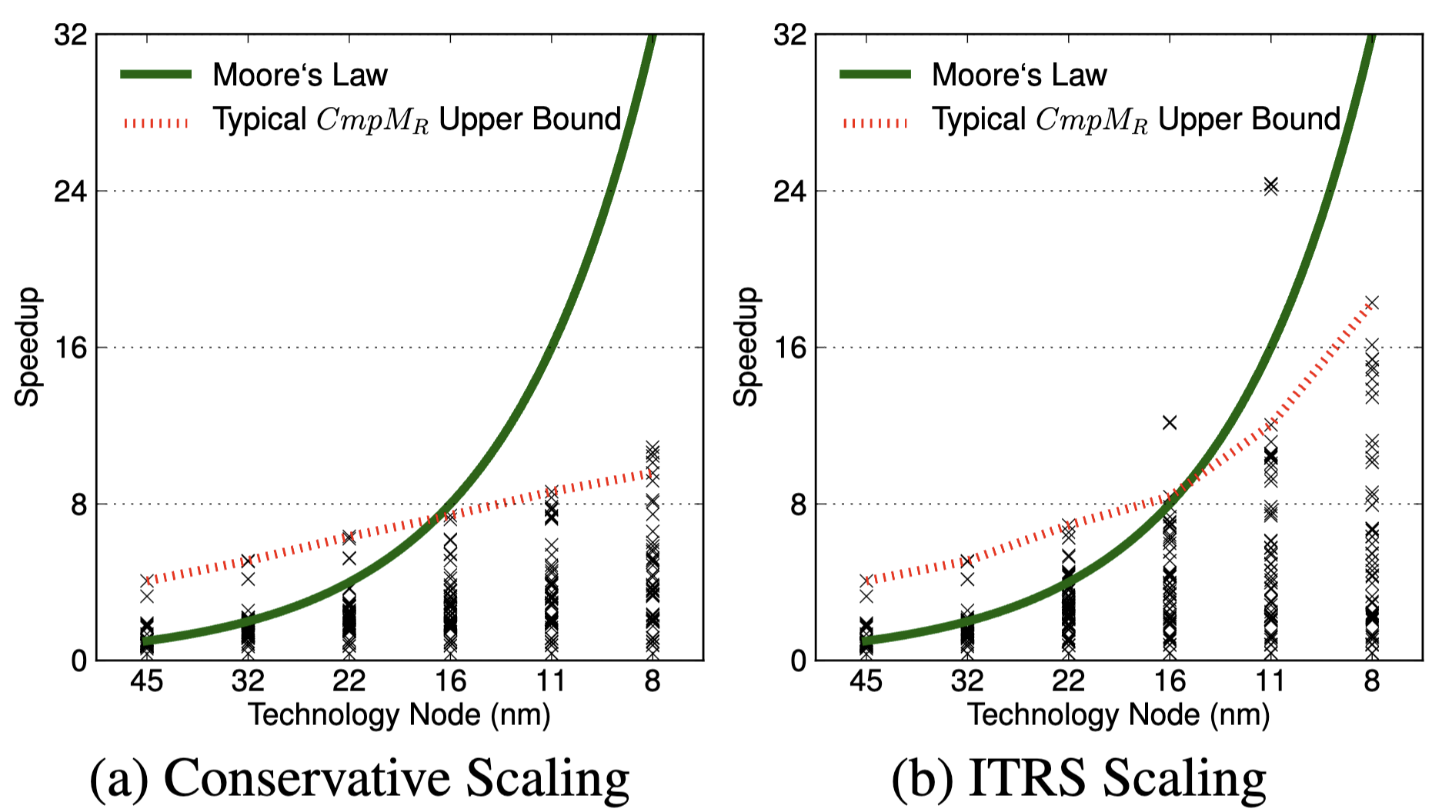
The Real Point

Slide 22
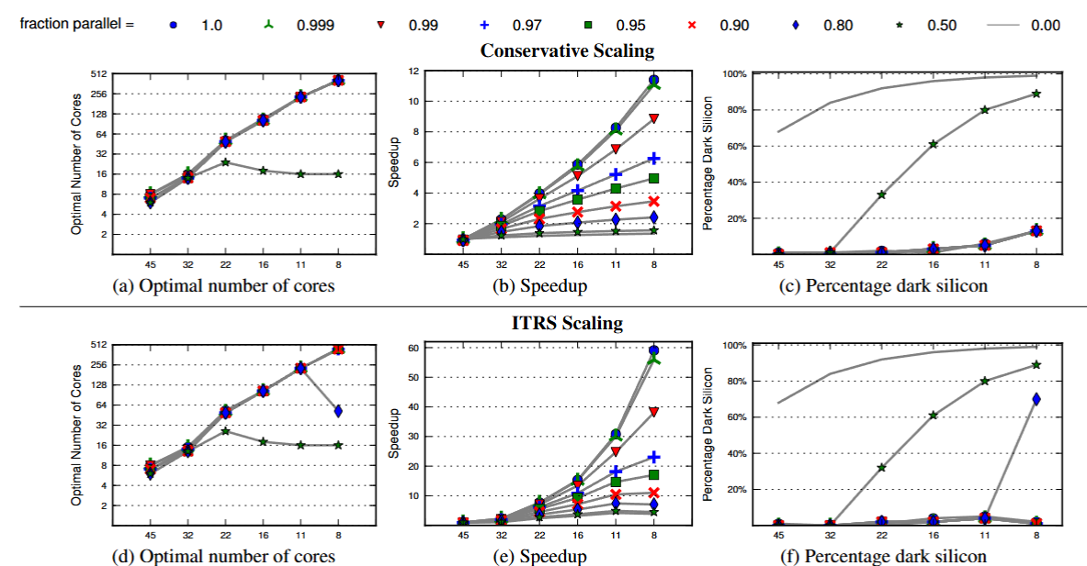
DevM X CoreM X CmpMu Results (dynamic top.)
Notes:
Projects 8nm processor to have frequency of 11.78 GHz!

Slide 23
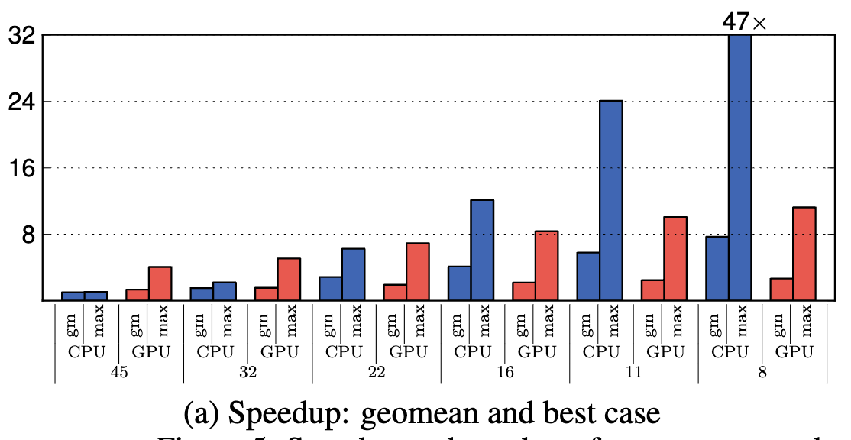
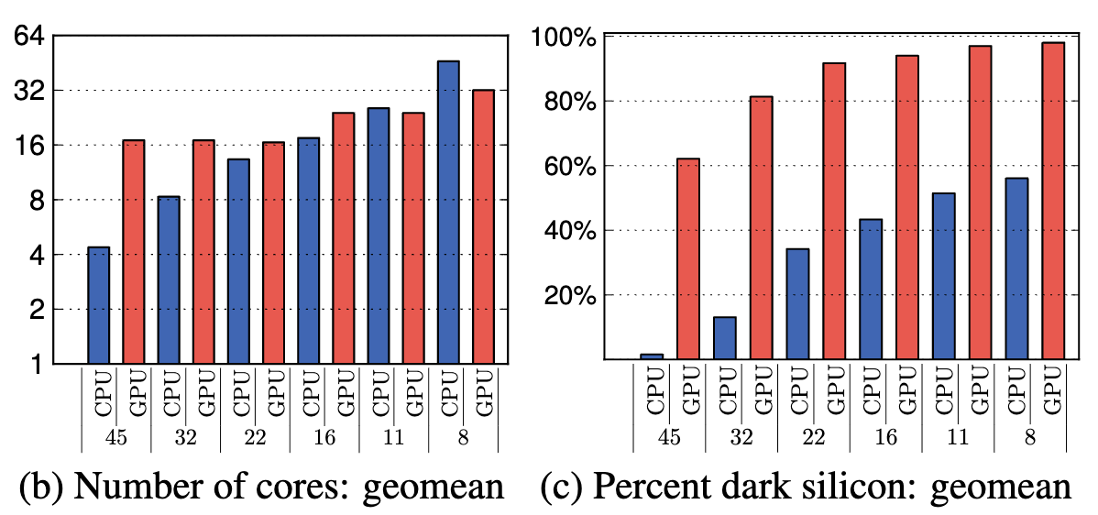
DevM X CoreM X CmpMr Results
Geomean speedups are small compared to past gains from technology scaling
Optimal number of cores plateaus
Dark silicon percentages grow very fast

Slide 24
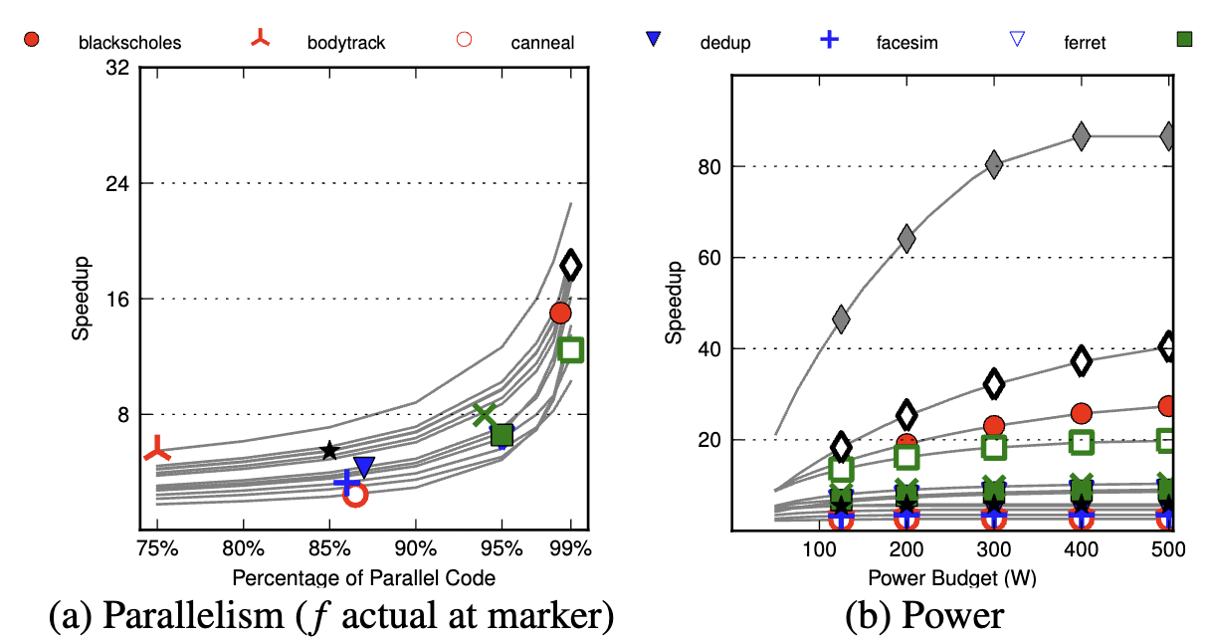
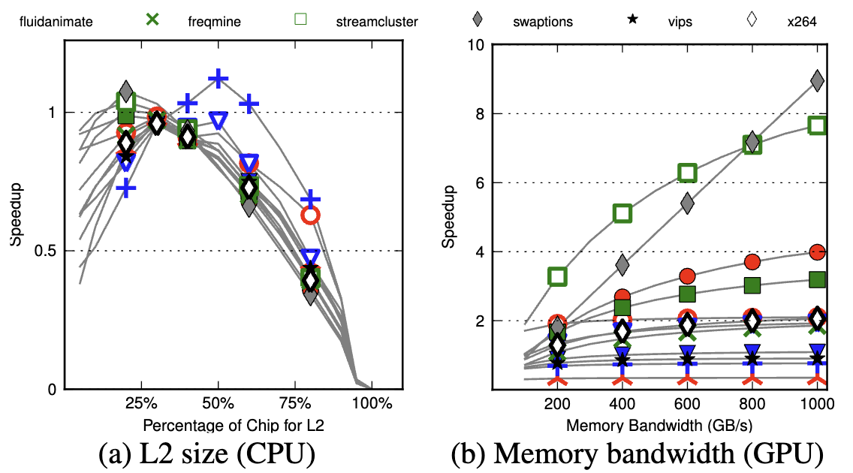
DevM X CoreM X CmpMr Results (8nm)
Only the most parallel workloads get significant speedups
Increasing the power budget doesn’t alleviate this problem
Simple configuration changes (e.g. L2 size or memory bandwidth) cannot alleviate this problem
Notes:
Each point on the graphs is a different benchmark

Slide 25
The Real Point

Slide 26
Limitations (of the paper or conference format)
No consideration of SMT in results
Potential overestimation of GPU power-budget
Ignore uncore
No consideration of ARM or Tilera cores
Many assumptions made to build a useful/useable model

Slide 27
It’s 2011 and we’re running into a problem
2011: Can fit more transistors on a processor but can’t fully power all of them at the same time.
  What do we do???

Slide 28
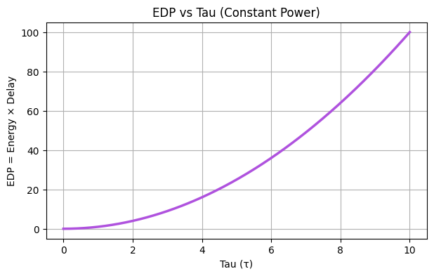
What if each core was more energy efficient?
Idea: Trade silicon area to implement logic for energy efficiency
  Reduces dark-silicon
Introducing conservation cores (c-cores)
Paper: Venkatesh et al., ASPLOS 2010 — “Conservation Cores: Reducing the Energy of Mature Computations”
Key evaluation metric: Energy Delay Product (EDP) = Eτ = Pτ²

Slide 29
Conservation Cores
Use c-cores for energy expensive code “hot code”
  loops, inner loops, frequently used functions, arithmetic
Code mustn’t change too much “mature code”
  Otherwise hardware is wasted
Minor code changes are adapted by the hardware “patched”
  Ensures longer lifetime of hardware

Slide 30
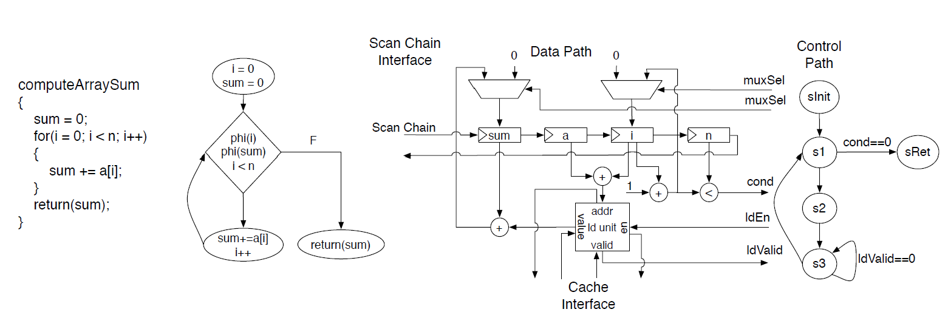
C-core Example

Slide 31
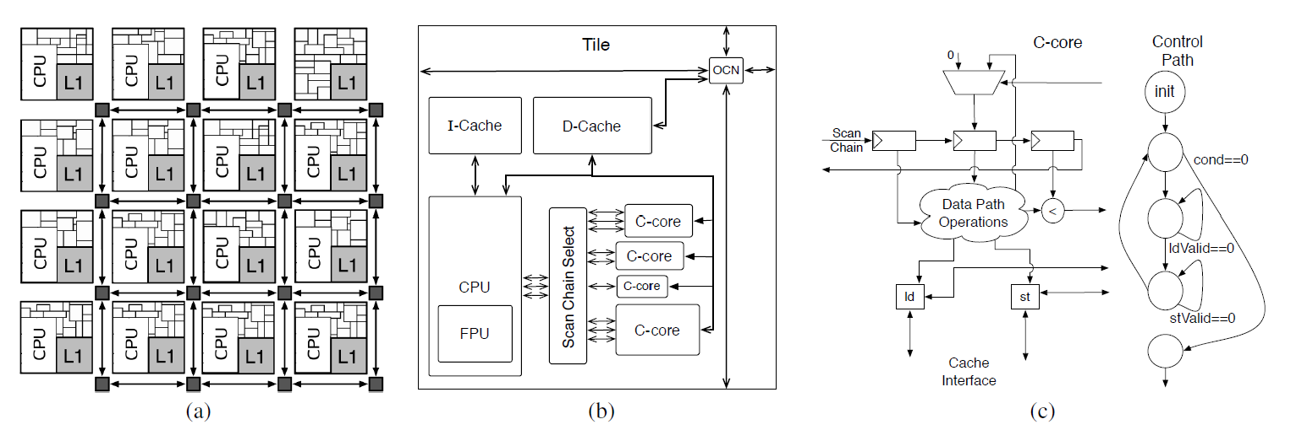
C-core Enabled System

Slide 32
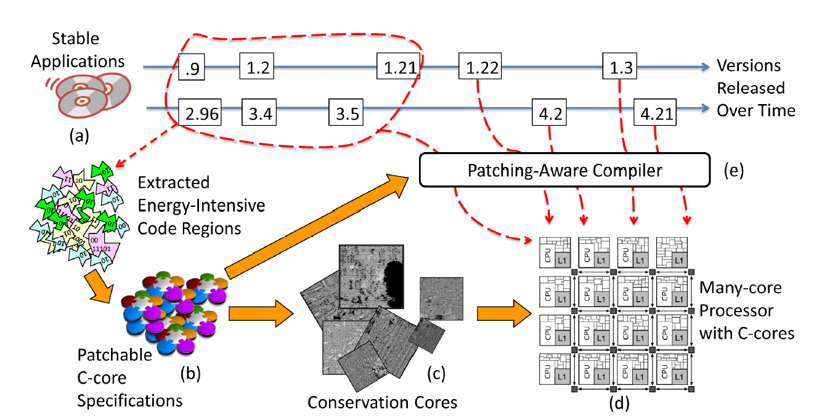
Synthesis & Compilation of c-cores

Slide 33
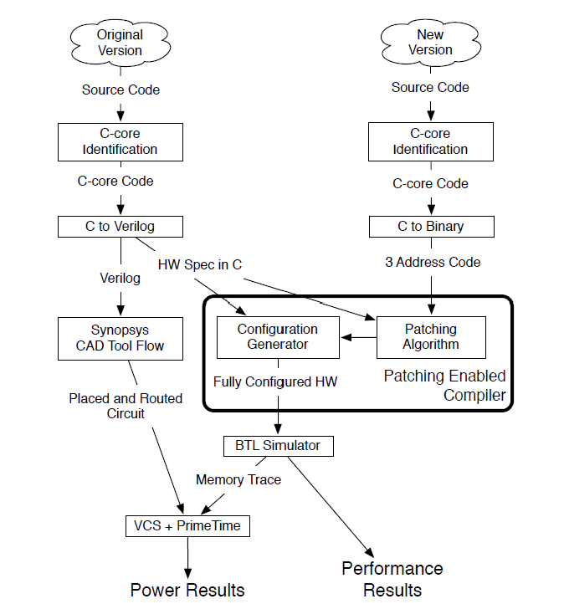
C-core toolchain

Slide 34
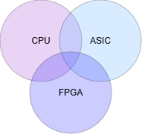
C-core Analogy
c-cores

Slide 35
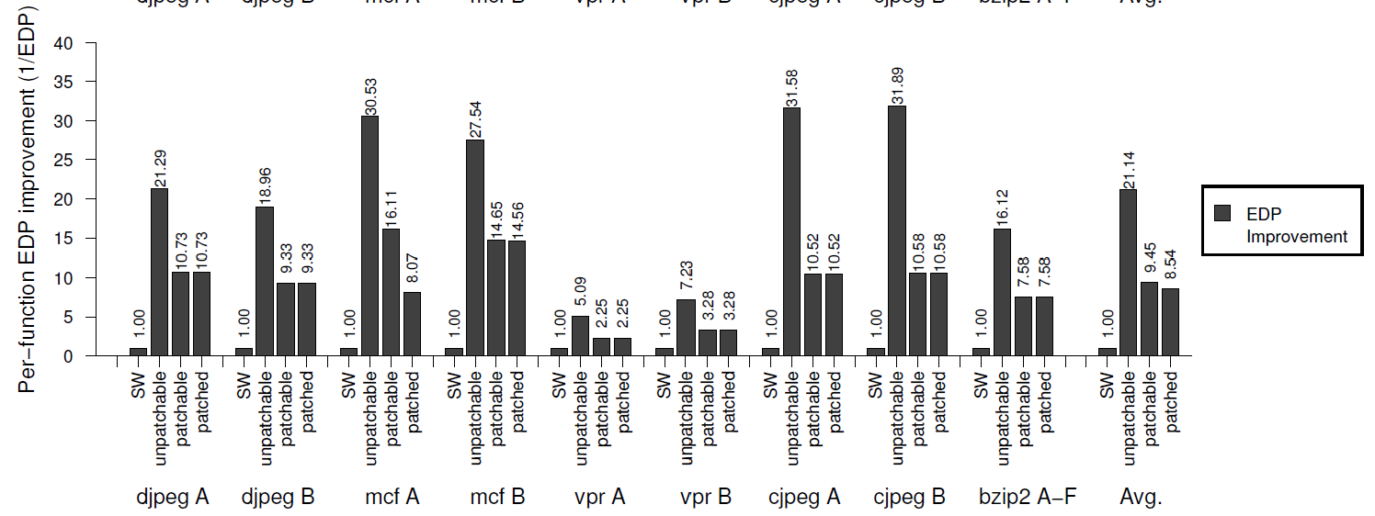
Function per EDP Results

Slide 36
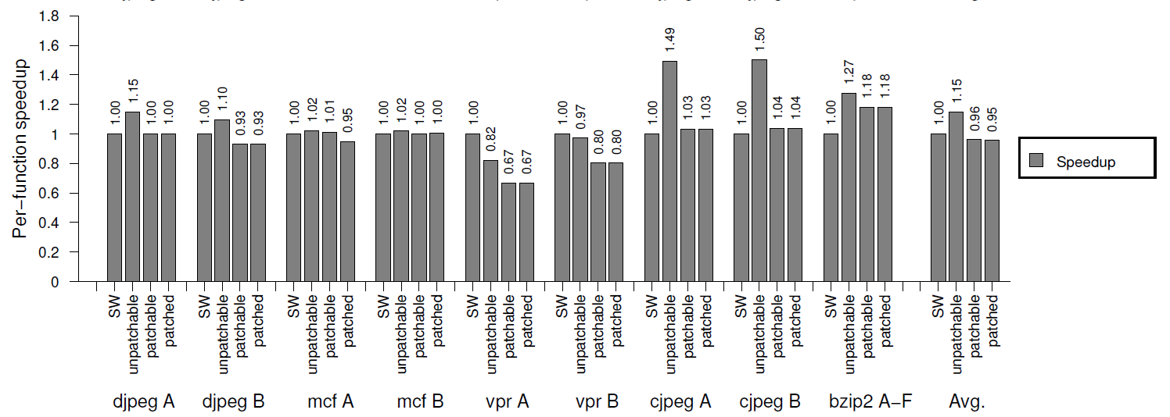
Speedup Results

Slide 37
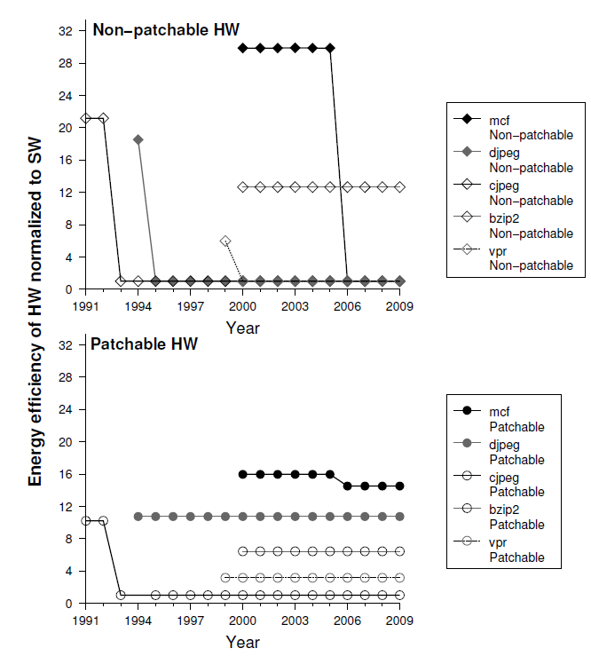
Effectiveness over Time Results

Slide 38
Limitations
Best suited for mature/slowly evolving hot-code; fast-changing code reduces value
Extra specialized cores increase design + verification complexity.
Less efficient than full ASIC accelerators due to patchability/generalization overhead.

Slide 39
Discussion

Slide 40
Discussion - General vs Domain-Specific
“Should we try to reduce dark silicon at any cost or should we embrace it by spawning multiple accelerators?” - Ferran Hermida
“Where do we draw the line between c-cores and the sea of accelerators design?” - Angela Yue Cui
“How robust are c-cores to software changes, and up to what point do you think it would be better to just design domain-specific chips?” - Tofic Esses
“To what extent does specialization reduce total system cost once engineering complexity and software support are considered?” - Jiaqi Huang

Slide 41
Discussion - Area Compromise
“Will further development in c-core cause an issue on area?” - Shengmin Liu

Slide 42
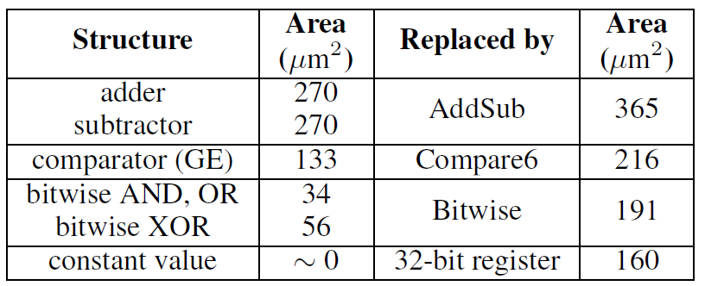
Discussion - Area Compromise
“Will further development in c-core cause an issue on area?” - Shengmin Liu
Section 7.2
“Patching support increases the area requirements of c-cores by 89% on average.”
Non-patchable
patchable

Slide 43
Discussion - The Dark Si Future
“Should future chips be designed assuming that only a fraction of hardware is active at any time?” - Shengmin Liu
“What is your vision to tackle dark silicon while improving performance and energy efficiency?” - Tofic Esses

Slide 44
What could we (did we) do about dark silicon after these papers?

Slide 45
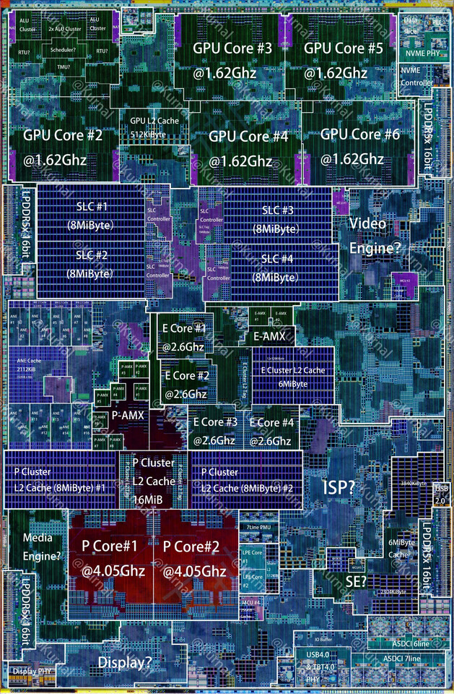
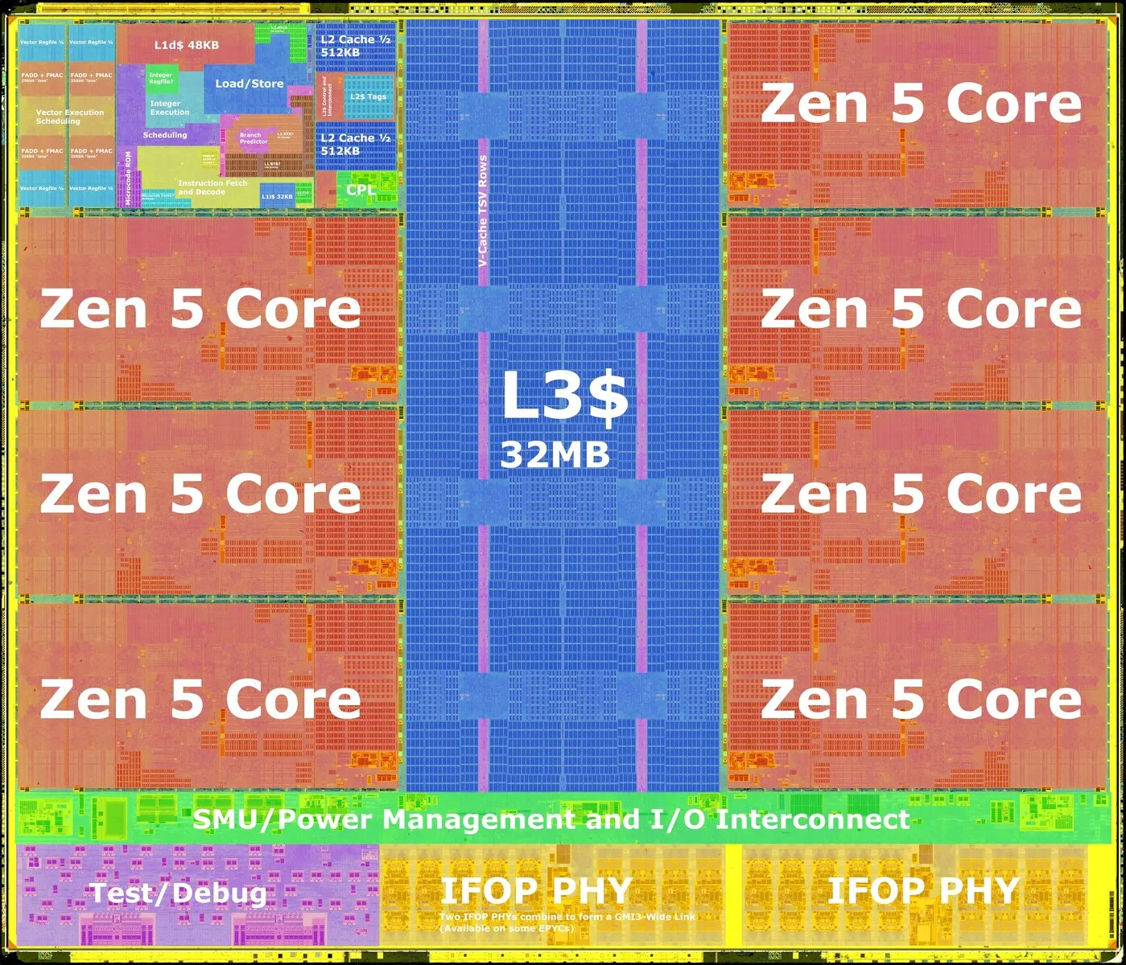
Dark Silicon in 2026
Here are some die shots of contemporary processors. Where is the dark si?

Slide 46
“Is Dark Silicon Useful? Harnessing the Four Horsemen of the Coming Dark Silicon Apocalypse”
Shrink
Dim
Specialize
Change (at device level)
Better cooling?
Which of these do we see?
M. B. Taylor, "Is dark silicon useful? Harnessing the four horsemen of the coming dark silicon apocalypse," DAC Design Automation Conference 2012, San Francisco, CA, USA, 2012, pp. 1131-1136.

Slide 47
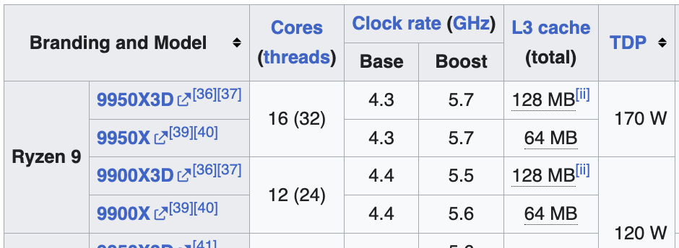
Is Dark Silicon Useful Acceptable?
Dim ( + better cooling):
Base vs Boost clocks
Specialize: “The CPUs in modern [mobile] SoCs… occupy only a small percentage of the die area. The rest of the SoC is committed to a potpourri of different accelerators, such as the DSP, GPU, ISP, NPU, video, and audio codecs.”
Reddi & Hill, Communications of the ACM, 2021

Slide 48
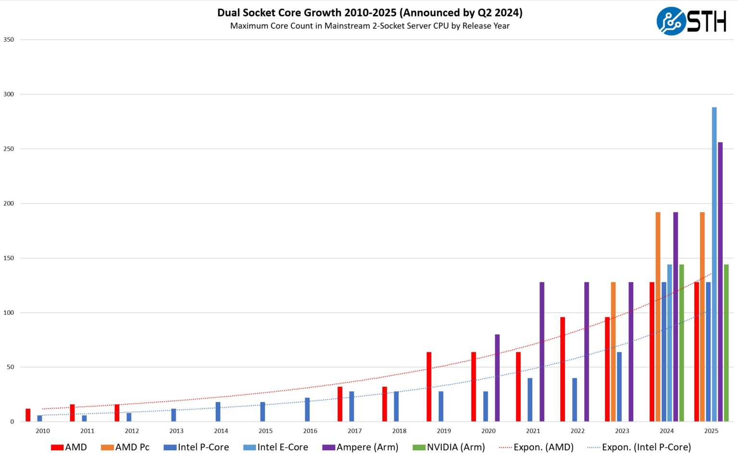
Multicore Scaling after this Paper

Slide 49
Discussion - Extra Power
“How do the authors plan to use the extra power budget they have won by reducing the energy/instruction ratio?” - Ferran Hermida

Slide 50
Discussion - Extra Power
“How do the authors plan to use the extra power budget they have won by reducing the energy/instruction ratio?” - Ferran Hermida
Abstract
“In this regime, specialized, energy-efficient processors can increase parallelism by reducing the per-computation power requirements and allowing more computations to execute under the same power budget.”

Slide 51
Discussion - Sustainability
“‘Conservation cores’ implies concern over environmental impact of computing. Are conservation cores the most sustainable way to move forward in the dark silicon era?” - Jack Toubes
Notes:
Moving from power into sustainability broadly :)

Slide 52
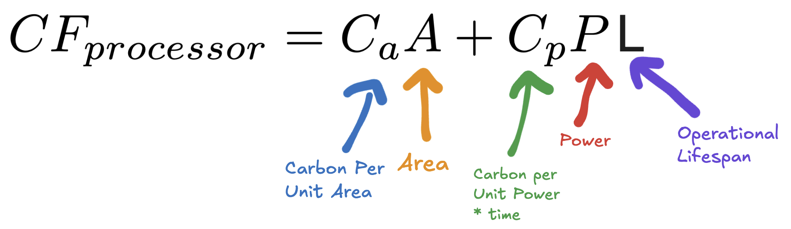
Carbon Footprint of a Processor

Slide 53
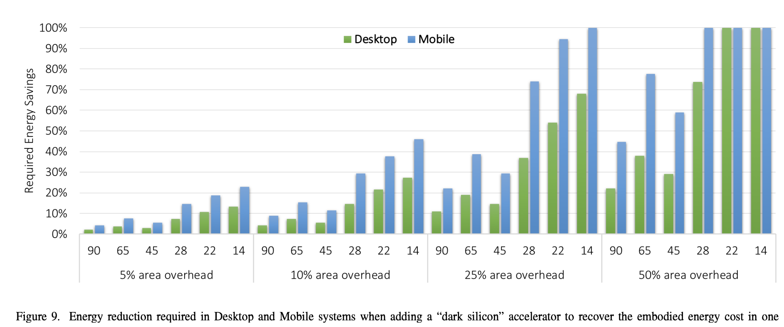
Are “conservation” cores carbon efficient?
Are accelerators?
E. Brunvand, D. Kline and A. K. Jones, "Dark Silicon Considered Harmful: A Case for Truly Green Computing," 2018 Ninth International Green and Sustainable Computing Conference (IGSC), Pittsburgh, PA, USA, 2018, pp. 1-8, doi: 10.1109/IGCC.2018.8752110.

Slide 54
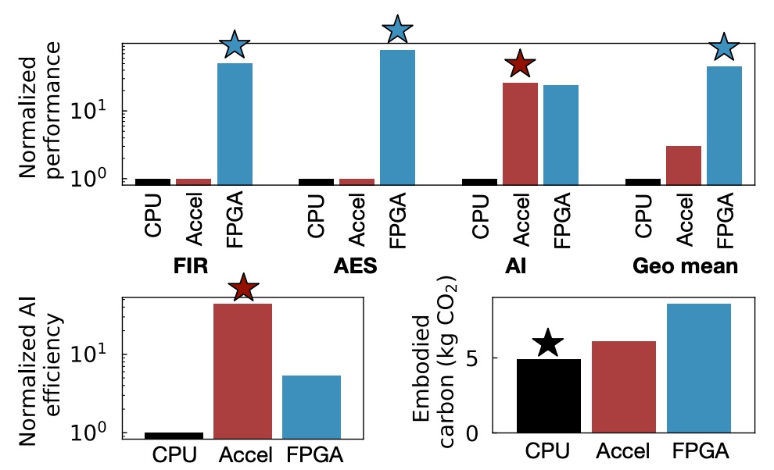
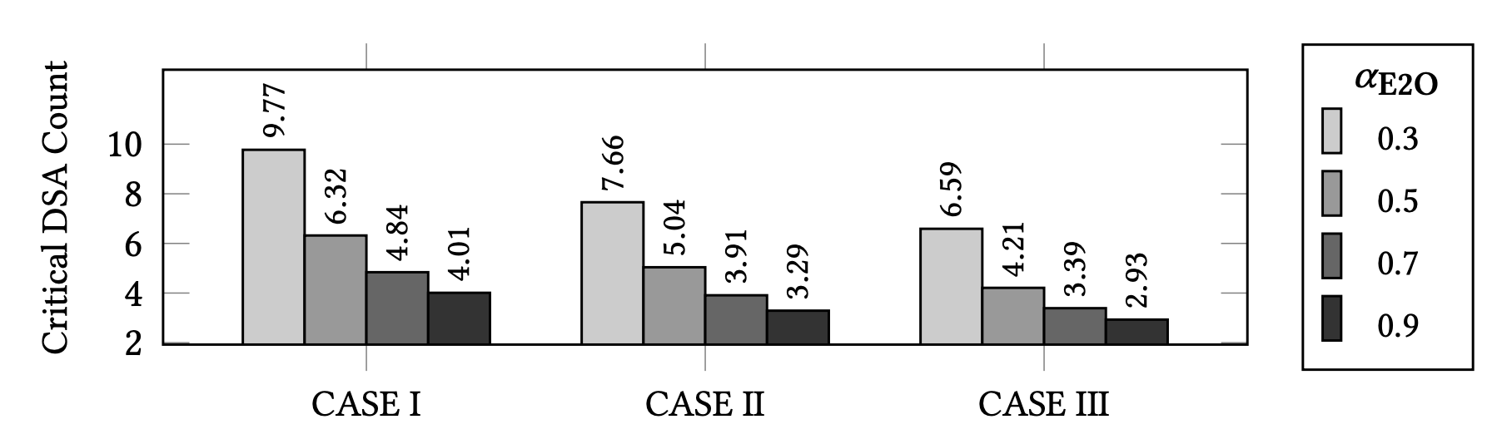
What about FPGA acceleration?
CGRA acceleration?
Udit Gupta et al., ACT, ISCA, 2022
Pranav Dangi et al., Sustainable HW Specialization, ICCAD, 2024

Slide 55
Discussion - ISA Change
“I would be interested to have a quantification of the overhead of a context switch from CPU to c-core.” “Did [scan chain access] necessitate an ISA change? Could scan chain access have been performed with memory mapped io?” - Jack Toubes

Slide 56
Discussion - ISA Change
“I would be interested to have a quantification of the overhead of a context switch from CPU to c-core.” “Did [scan chain access] necessitate an ISA change? Could scan chain access have been performed with memory mapped io?” - Jack Toubes
Section 4.2 Regarding datapath scan chains
To access the interface, the CPU provides three new instructions: Move-From-ScanChain (MFSC), Move-To-ScanChain (MTSC), and ScanChain-Rotate-Left (SCRL). MFSC moves the 32 bits at the head of a scan chain into a general purpose processor register, and MTSC does the reverse. SCRL rotates a scan chain left by n bits. SCRL executes asynchronously but MFSC and MTSC have blocking semantics: They will wait for previously issued SCRLs on a scan chain to finish before returning a value from that scan chain.

Slide 57
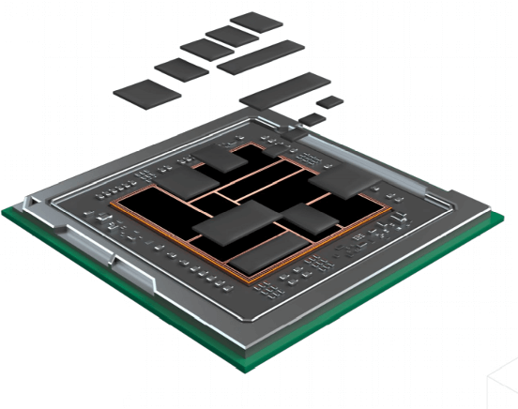
Discussion - c-core vs chiplets, near mem proc.
“How does the c-core philosophy compare to modern chiplet-based specialization or near-memory processing?” - Jiaqi Huang

Slide 58
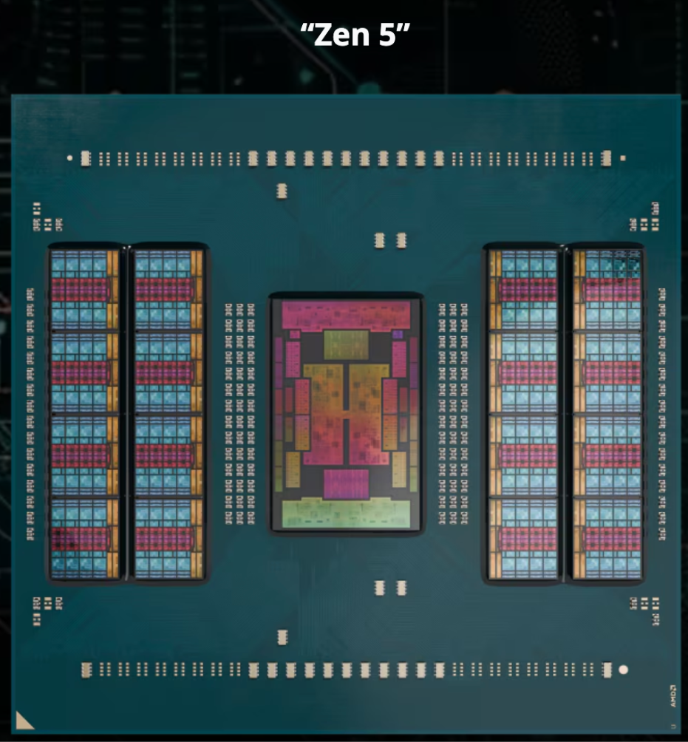
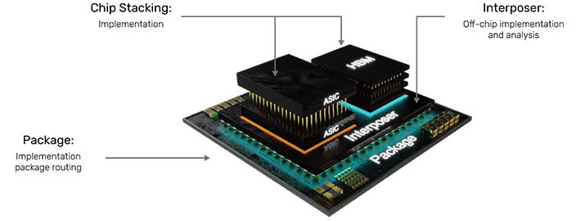
Discussion - Packaging and Power Density
Notes:
Up to 16 CCDs in Zen5 + big IO die

Slide 59
Discussion - OoO c-cores
“Could out-of-order execution techniques be incorporated into c-cores without losing their energy advantage?” - Shengmin Liu

Slide 60
Discussion - Wimpy Cores
“How would a Wimpy core strategy behave instead of this and what would be the limits of improvement if any?” - Ferran Hermida
V. Gupta and K. Schwan, "Brawny vs. Wimpy: Evaluation and Analysis of Modern Workloads on Heterogeneous Processors," 2013 IEEE International Symposium on Parallel & Distributed Processing, Workshops and Phd Forum, Cambridge, MA, USA, 2013, pp. 74-83, doi: 10.1109/IPDPSW.2013.130.
keywords: {Program processors;Performance evaluation;Multicore processing;Servers;Benchmark testing;Browsers;Mobile handsets},

Slide 61
Discussion - Anything Else?
Any pressing questions or perspectives you would like to share?

Slide 62
End
Thank you for your attention and participation in the discussion!

Slide 63
Backups / Extras

Slide 64
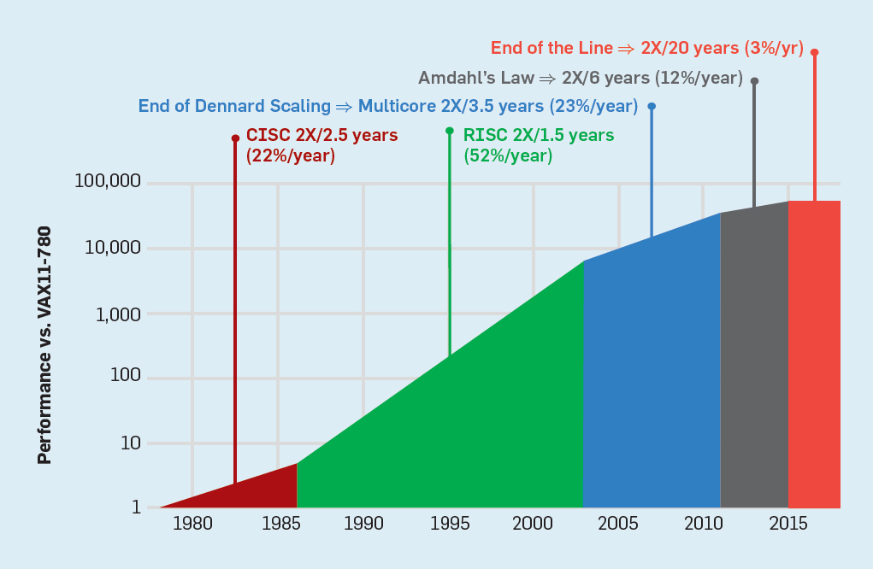
Background: A story told by 2 graphs (1)
We are here

Slide 65
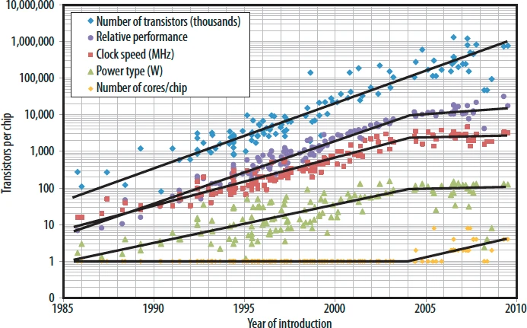
Background: A story told by 2 graphs (2)
We are here

Slide 66
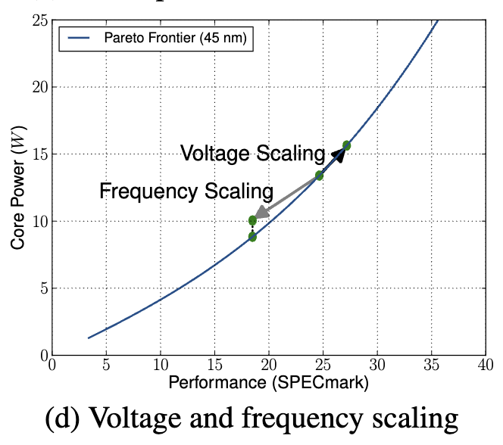
Core Scaling Model (CoreM)
Can use voltage and frequency scaling to push a core harder (using more of your power budget) or less hard (using less of your power budget)

Slide 67
Realistic Multi-core Performance (CmpMr)
Fill in parameters using core models from before
  Convert SPECmark score into estimated CPI & frequency
    Assume everything else equal for two cores, set CPI to equalize the ratio of their CmpMr scores, to their SPECmark scores.
    Assume CPI does not change with technology node
  Rely on past studies for application behavior characterization.
  Separate consideration of single-thread vs many-thread (GPU) cores

